Slide 1
Differentiation through
Data Analytics
by
Venkat Subramanian & William Martens

Slide 2

The Walmart AMP

Slide 3

The business problem
The Walmart AMP has great data but…
It is not easily interpreted
It is not useful for decision-making
It is a bit messy

Slide 4

Our business solution
A Python program that
Reads the data
Transforms the data
Provides visuals of the data
Creates decision-making tool for streaming data

Slide 5
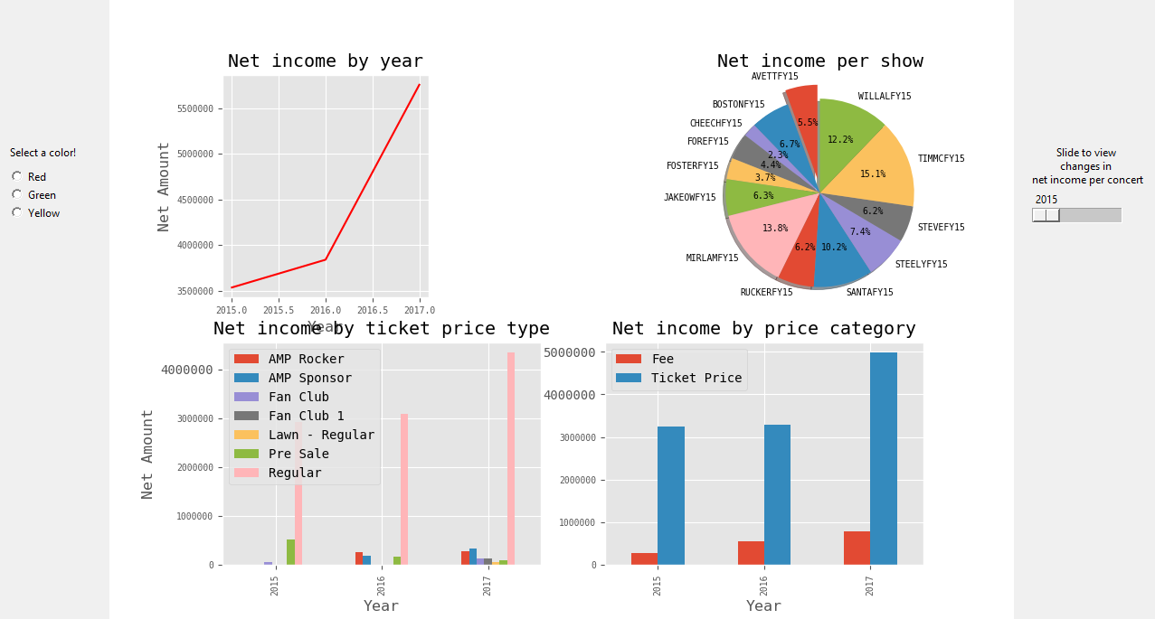
The results
Fully functioning Python program
Produces a data dashboard for management

Slide 6
Thank you
Image sources
https://www.python.org/community/logos/
https://twitter.com/walmart_amp
Venkat & Will

